Slide 1
Adaptations over time
Evolution

Slide 2
Bell work connection to heredity
How is heredity and evolution related??

Slide 3
The Big Ideas this Chapter
Life-forms have changed over time
Charles Darwin and other scientists observed that species changed over time by different methods
Scientists find clues about evolution by studying fossils, development of embryos, structures of organisms, and DNA.
Evidence indicates that the ancient ancestor of present-day humans appeared on Earth 4-6 million years ago.

Slide 4
Section 1: Ideas about evolution
Species: is a group of organisms that share similar characteristics and can reproduce offspring.
Evolution: Change in inherited characteristics over time.

Slide 5
Ideas about evolution
Darwin’s model of evolution
He Journeyed to the Galapagos islands. He was amazed by the diversity in animals and plants he had seen.
He decided to focus in on the finches of the island and found 13 similar species with small differences in size, beaks, and eating habits.
He hypothesized that these birds had once been the same species and over many generations changed to compete for food sources. After many years, the birds evolved into separate species of finches.
https://youtu.be/XKnqj3YFXU8
https://youtu.be/ppjDzcTeYMY

Slide 6
Ideas about evolution
After many years Darwin’s ideas became known as the theory of evolution by natural selection
Natural Selection: means that organisms with traits best suited to their environment are more likely to survive and reproduce.
Visual/Table:

Slide 7
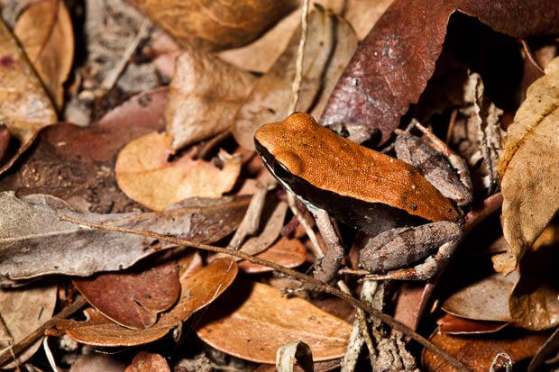
Ideas about evolution
Variation: is an inherited trait that makes an individual different from other members of its species. (Ex: Blue eyes vs. Brown eyes in humans)
Adaptation: is any variation that makes an organism better suited to its environment. (Ex: Camouflage)

Slide 8
Ideas about evolution
Word Evolution Activity
On a piece of paper, print the word TRAIN.
Add, subtract, or change one letter to make a new word.
Repeat the last step 3 more times.
Make a “family tree” that shows how your first word changed over time.
Compare your tree to those of other people. How is this process similar to evolution by natural selection??

Slide 9
Ideas about evolution
Is evolution a fast or a slow process??
About how fast or slow is it??

Slide 10
Ideas about evolution
There are two theories that scientists agree with:
Gradualism: the slow process of evolution that is gradual over many generations. Maybe even tens of millions of years.
Punctuated Equilibrium: rapid evolution comes when a mutation effects the genes of a species to make a whole new species.

Slide 11
Hidden Frogs
Hidden Frogs Lab- page 342

Slide 12
Section 2: Clues about Evolution
Bell work /Review

Slide 13
Clues about evolution
Most of the evidence for evolution comes from fossils.
Fossil: the remains, an imprint, or a trace of a prehistoric organism.

Slide 14
Clues about evolution
There are several types of fossils:

Slide 15
Clues about evolution
Determining a fossils age
Relative dating: using the idea that younger rock is found toward the top and older rock is found as you descend downward to estimate the age.
Radiometric dating: more accurate age estimation can be done by using the radioactive elements given off by the fossil.

Slide 16
Clues about Evolution
Is it easy for an organism to become fossilized?
How can fossils be used to help explain evolution?

Slide 17
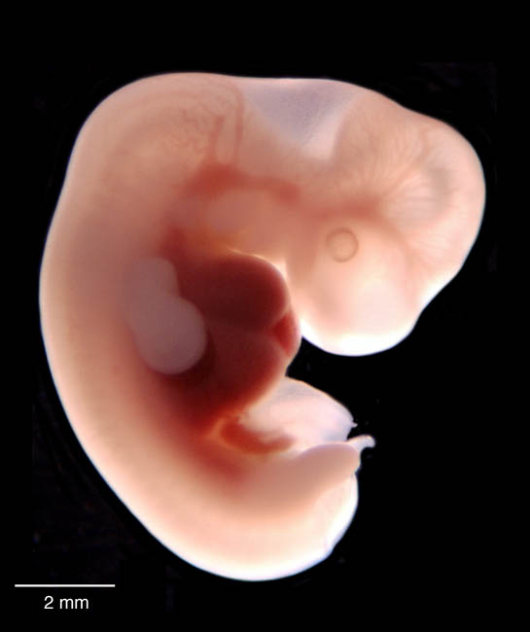
Clues about Evolution
Other evidence to support evolution:
Embryology: the study of embryos and their development.
Pharyngeal pouches
Postanal tail

Slide 18
Clues about Evolution
Other evidence to support evolution
Homologous structures: Body structures/parts that are similar in origin and structure.
Example: bones

Slide 19
Clues about Evolution
Other evidence to support evolution
Vestigial Structures: structures that don’t seem to have a function.
Example: human ear muscles vs. other mammals moveable ears.
Visual:

Slide 20
Clues about Evolution
Other evidence to support evolution
DNA: By looking at DNA of different animals, scientists can determine how closely related some organisms are.
Example: Apes and Humans :23 vs. 24 chromosomes.

Slide 21
Sec 3: The Evolution of Primates
Questions/review

Slide 22
The Evolution of Primates
Primates: human, monkeys, and apes belong to this group of mammals.
All primates have..
Opposable thumbs in order to grasp and hold things.
Binocular vision in order to judge depth or distance with our eyes.
Flexible shoulders in order to rotate our arms.

Slide 23
The Evolution of Primates
Living without thumbs mini lab- page 351
Open your agenda!!!
Lab reflection questions Due tomorrow ☺

Slide 24
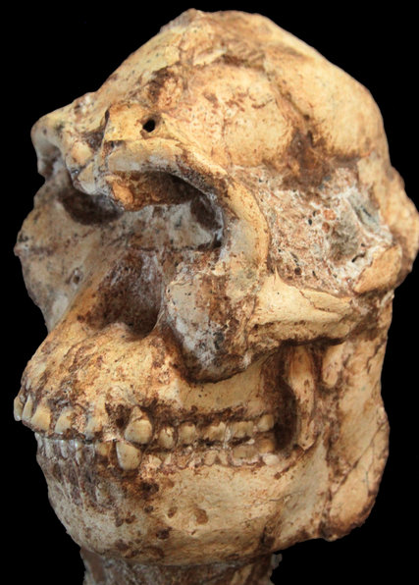
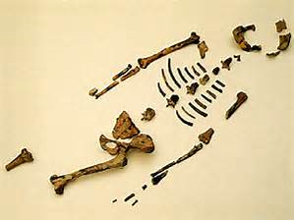
The Evolution of Primates
About 3.5 million years ago, humanlike primates appeared that were different from other primates. These new ancestors are called Hominids.
Oldest (left) “little foot” 3.5mya
2nd oldest Hominid fossil found: “Lucy” 3.2mya

Slide 25
The Evolution of Primates
Homo sapiens, or humans, evolved about 400,000 years ago
Neanderthals: short, heavy bodes, thick bones, small chins, and heavy brow ridges.
30,000 years ago
Cro-Magnon Humans: almost the same as modern humans. They made art, stone carvings, and used animals for travel.
10,000 years ago

Slide 26
Chapter Review
Questions/Review
https://youtu.be/P3GagfbA2vo?list=PL3EED4C1D684D3ADF

